Slide 1
Introduction to AI – Reinforcement Learning and Genetic Algorithms
Philip Mortimer

Slide 2
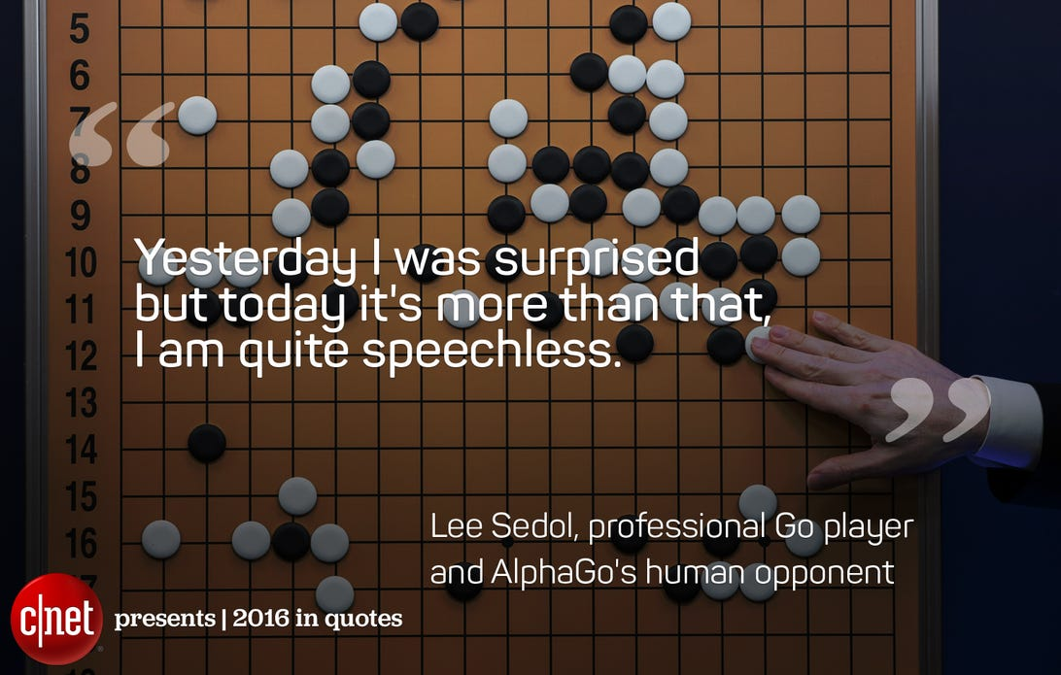

Slide 3
Summary
We discussed unsupervised learning
Unsupervised learning is a term that covers a wide range of algorithms that draw inferences from unlabelled data
K-means clustering is a way of dividing a dataset into k groups. Datapoints within groups are likely to share similar attributes
Autoencoders use data as both an input and as a training label
Autoencoders consist of two neural networks: an encoder and a decoder
The encoder compresses the original input. The decoder converts the compressed representation to the original format

Slide 4
Summary
Autoencoders can be applied to image compression and image enhancement
Discussed principal component analysis (PCA)
This is a method that converts the attributes of a dataset into a different set of attributes in such a manner that as much information as possible is encoded in the first principal component
As much remaining information is then encoded in the second principal component and so on
This allows us to not store the z least valuable principal components, thus significantly reducing the dimensionality of our data

Slide 5
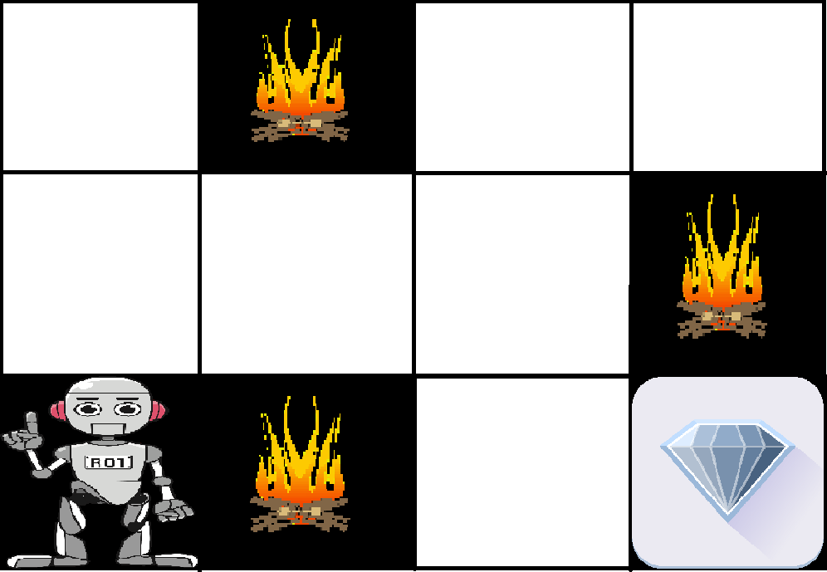
Reinforcement Learning
Reinforcement learning is different to other forms of learning as it does not require any sort of dataset (labelled or not)
Reinforcement typically involves an agent, an environment and a set of goals
Take this example of a robot in a maze, with some obstacles and a reward

Slide 6
Reinforcement Learning
In this case our agent is the robot and our environment is the maze
This may be a real world maze, or it may be a very large maze simulation on a computer
In either case, we may not able to compute a solution to the problem
Supervised learning is unsuitable as we can’t generate data and corresponding labels for optimal moves

Slide 7
Reinforcement Learning
Unsupervised learning is also not suitable as meaningful data analysis / collection is computationally impossible
As the problem space may be unknown or too large to enumerate over, what we do instead is define a set of actions that have scores associated with them
For example, we may say that hitting an obstacle results in -100 points

Slide 8
Reinforcement Learning
Finding a diamond may result in a score of +100 points
We then take actions and reward our AI for doing good things and punish it for doing bad things
Reinforcement learning (RL) is often compared to training a dog. If we throw a stick and the dog retrieves it, we may reward it with a treat. Conversely, if the dog is badly behaved, we may choose to not reward it
Over time, our dog learns to behave well

Slide 9
RL
The idea is that RL involves an environment state and a sequence of actions that can be taken for each state
A new state can be fully described by the previous state and the action taken at that state
After we take our actions, we can reward or punish or agent depending on our reward policy

Slide 10
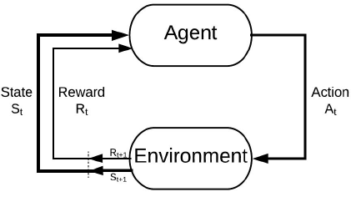
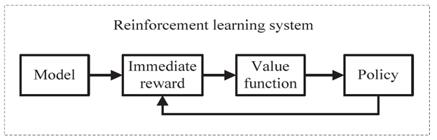
Reinforcement Learning

Slide 11
Reinforcement Learning
Reinforcement learning can be broken down into two broad categories: model-based and model-free
A model is simply something that takes a state and an action and converts it into a new state.
In a game of chess, we already have the model (we know exactly how each move should change the state)
However, we may have a robot that is operating in the real world. If the set of actions it can take are sufficiently complex, we wouldn’t be able to code a perfect model (without knowing all of the laws of physics). In this case, we simply have a current state and a set of actions we can take
Note that in model-free, we still can take an action and get a future state

Slide 12
Model-Free Learning
The most common algorithm that doesn’t require a model, is called Q learning
Q learning requires no prior knowledge
Q learning creates a table which stores all possible actions and then which actions lead to various environment states
All we need to know is the start state and the set of possible actions.
To introduce this, we will look at a simple example

Slide 13
Q Learning
Let’s say we have a ball that can be at any point along this one dimensional line
The goal is to reach the goal (in this case labelled “beer”)
If we fall in the “hole” area, we lose
In our case, we may be in three states: winning, losing or undetermined.
Let’s say that “winning” actions give us a score of +100. “Losing” is -100 and “undetermined” is 0.
This is our reward policy
Credit: https://itnext.io/reinforcement-learning-with-q-tables-5f11168862c8

Slide 14
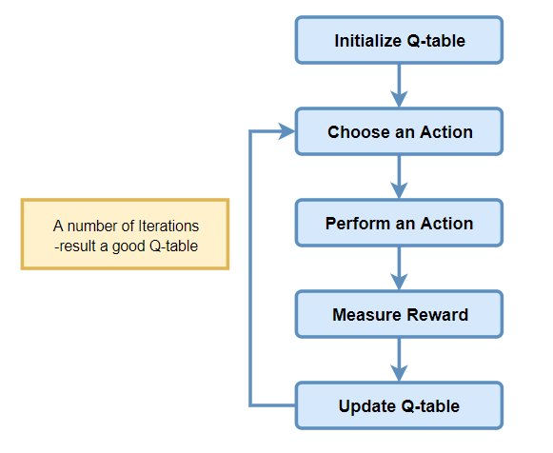
algorithm

Slide 15
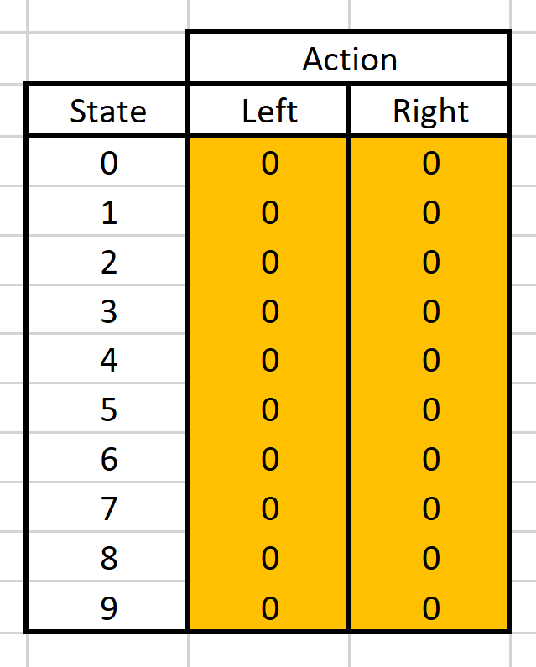
Initialise Q Table
We need to initialise our Q table. This table stores our maximum expected reward for taking a certain action at a certain state
We initialise each item in our table to zero

Slide 16
Playout
We know play lots of random game playouts
Each time we are at a given move, we update our Q table using a formula known as the Bellman equation

Slide 17
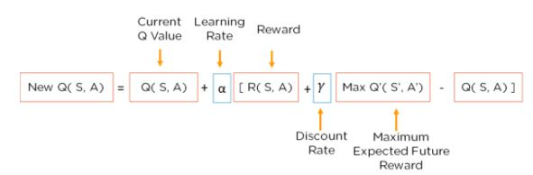
Bellman Equation
We are at a state and we select an action semi-randomly using an epsilon greedy approach
This means that we are more likely to choose “good actions” but also have a chance of exploring other states
As training goes on, we are less likely to explore
Note Q(S, A) just denotes an item in our table where S is the state and A is the action
Learning rate and discount rate are hyperparameters

Slide 18
Bellman Equation
R(S, A) is our reward policy for the action in the current state (+100 for a win, -100 for a loss etc.)
Max Q’(S’, A’) refers to the maximum value in the q table for the new state S’. S’ = the new state resulting from taking action S at state A.
Thus, we are finding the best possible value for the next state after taking the action

Slide 19
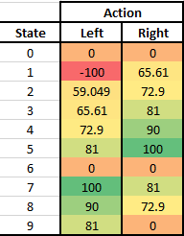
Q-Learning
Through iteratively running this algorithm, we train an agent to play the game
When using this agent in the real world, we will select the value from the Q table for the current state that leads to the best future reward

Slide 20
Q-Learning
Q-Learning makes produces it’s own estimate of the actual model, as well as optimal policy
This makes it very prone to errors and also less effective than supervised approaches
It also takes up a lot of memory and becomes tricky to use for very large state spaces
Deep Q learning is a modern solution to this issue, which makes it make more feasible for real world use

Slide 21
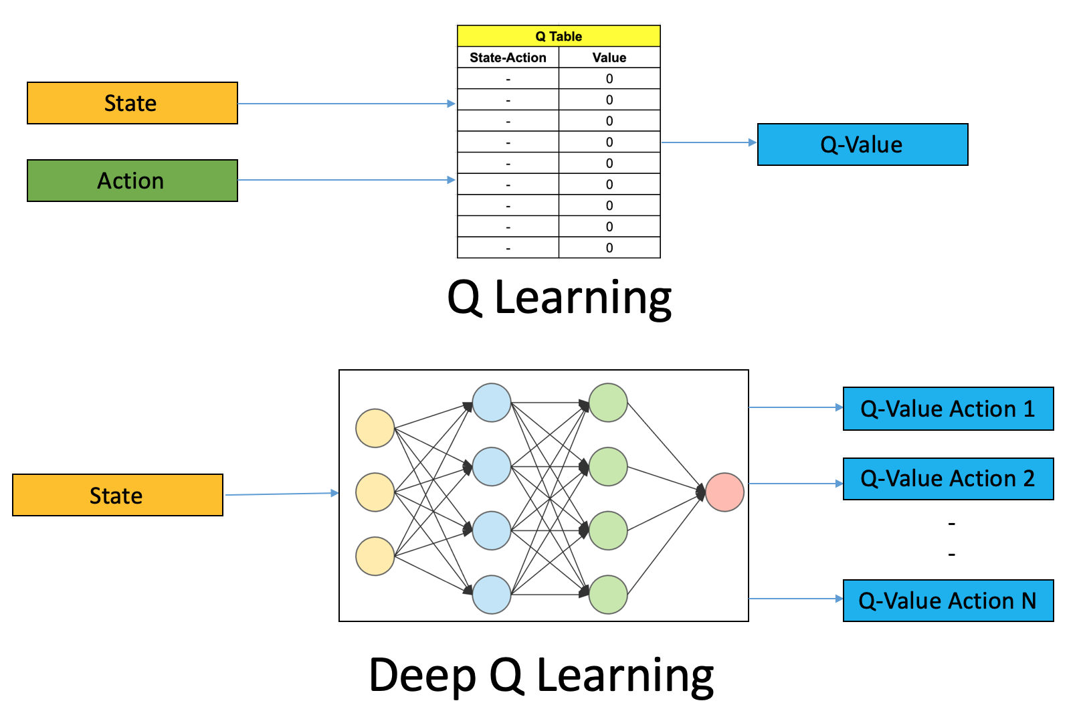
Deep Q Learning
The details are complicated, however the long and short is that it performs very well and is a versatile algorithm
The idea is that we have a deep neural network that replaces our table

Slide 22
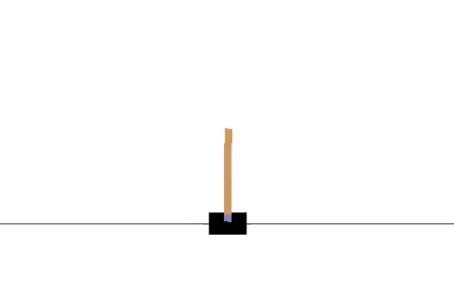
Deep Q Learning
We can train a deep q model. I have written code to do so here: https://github.com/philipmortimer/MNIST-TF/tree/main/cartpole
Here’s the output of a trained deep q model on Cart Pole game

Slide 23
Monte Carlo Tree Search
Monte Carlo Tree Search (MCTS) is a tree search algorithm often used to search a game tree (which is what the minimax algorithm does)
MCTS is very useful for games with a high branching factor, games where heuristics are hard to define and games where imperfect information / probability is present
Given infinite compute time, it will make an optimal decision (converge to minimax)
MCTS has been successfully applied to games like Go, which (until recently) has been an area of failure for AI research

Slide 24
Monte Carlo Tree Search
MCTS involves four phases
Selection – Select nodes from the root that represent good “moves”
Expansion – If our selected leaf node is not a terminal node, generate all possible future nodes and select one. Only do this if the node has already been explored
Simulation (rollout) – Run a simulation (playout) of random moves from the selected move and store the eventual game result
Backpropagation – Update the current move sequence with the result

Slide 25

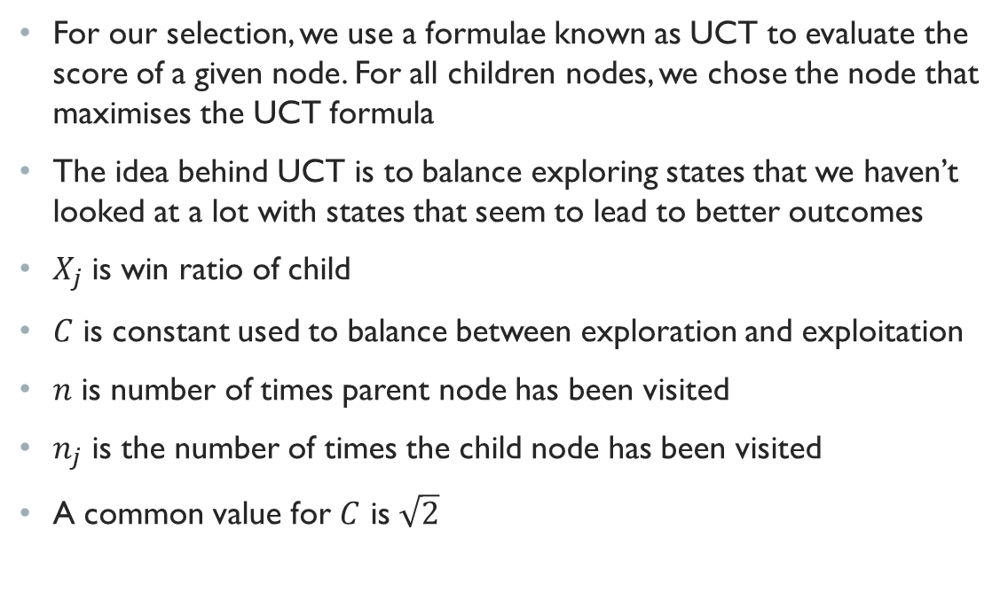
UCT
For our selection, we use a formulae known as UCT to evaluate the score of a given node. For all children nodes, we chose the node that maximises the UCT formula
The idea behind UCT is to balance exploring states that we haven’t looked at a lot with states that seem to lead to better outcomes
$X_{j}$ is win ratio of child
$C$ is constant used to balance between exploration and exploitation
$n$ is number of times parent node has been visited
$n_{j}$ is the number of times the child node has been visited
A common value for $C$ is $\sqrt{2}$

Slide 26
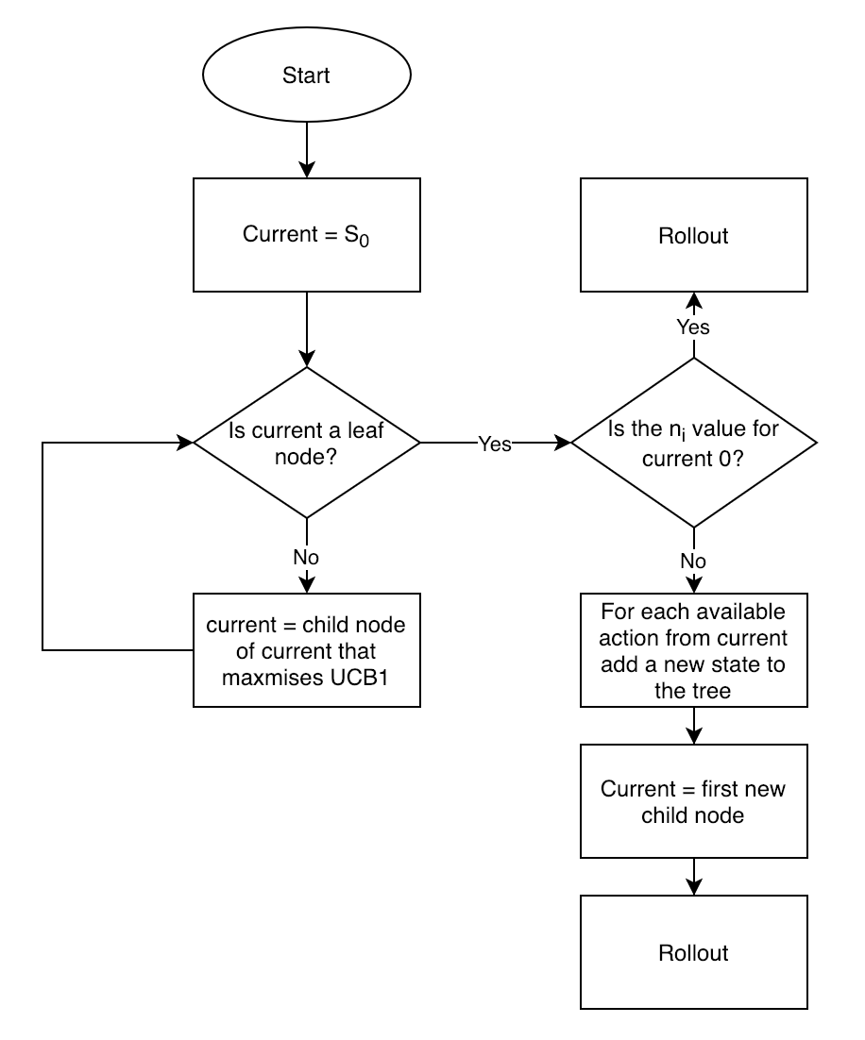
MCTS

Slide 27
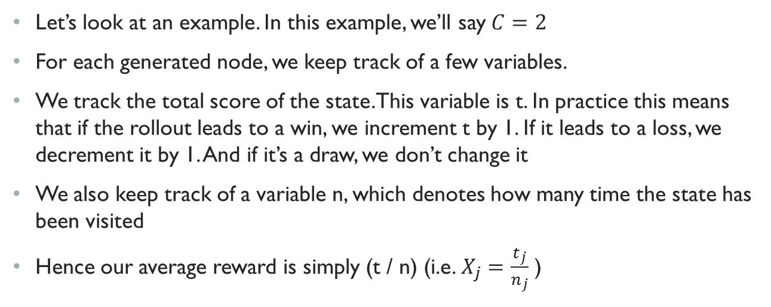
MCTS
Let’s look at an example. In this example, we’ll say $C=2$
For each generated node, we keep track of a few variables.
We track the total score of the state. This variable is t. In practice this means that if the rollout leads to a win, we increment t by 1. If it leads to a loss, we decrement it by 1. And if it’s a draw, we don’t change it
We also keep track of a variable n, which denotes how many time the state has been visited
Hence our average reward is simply (t / n) (i.e. $X_{j}=\frac{t_{j}}{n_{j}}$ )
Credit: https://www.analyticsvidhya.com/blog/2019/01/monte-carlo-tree-search-introduction-algorithm-deepmind-alphago/

Slide 28
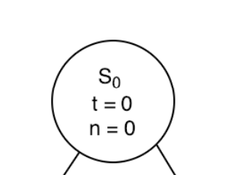

MCTS
We start with our root state $S_{0}$. We may imagine that each state represents a chess board, for example.

Slide 29
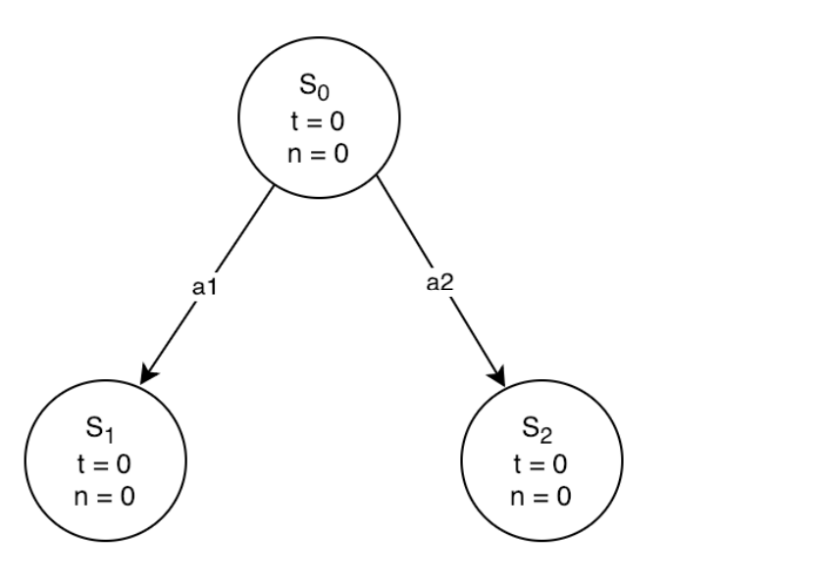
MCTS
As this is the root node, we perform the expansion phase.
Thus, we generate all possible actions from this state
In this case, we find that there are two possible actions, each leading to two different states
We add these to our game tree, with values of n and t initialised to 0

Slide 30
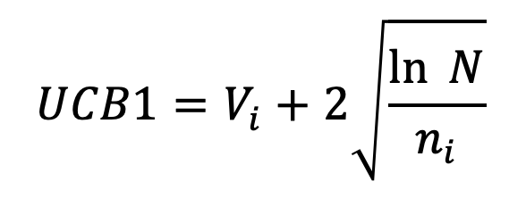

MCTS
Now, we have to choose which node to select (we are in the selection phase)
We apply the UCT formula to each node and select the node that maximises this value
In this case $UCB\left(S_{1}\right)=UCB\left(S_{2}\right)$
We treat unexplored nodes as having a UCB of +infinity
In this case, we randomly select one of the two states. Let’s choose $S_{1}$

Slide 31
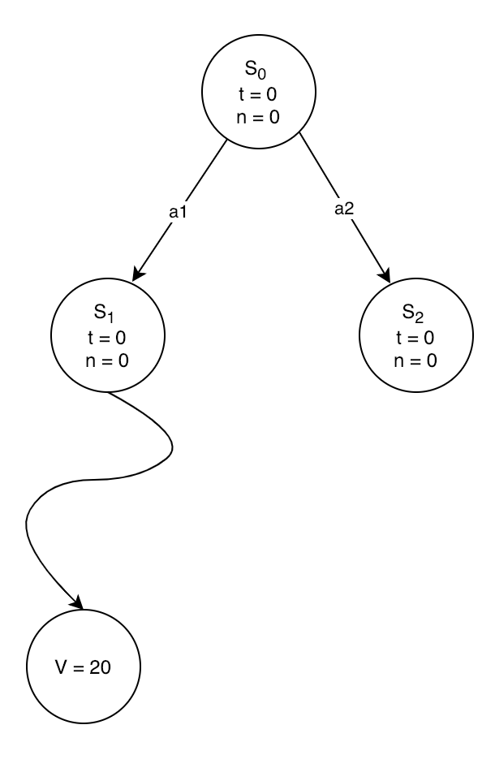

MCTS
We have selected $S_{1}$. This is used in the rollout phase
We start at $S_{1}$ and take random actions until we reach a terminal state.
This terminal state is assigned a score given our reward policy
In the case of chess (and this example), a score of 20 may represent a win for the root player

Slide 32
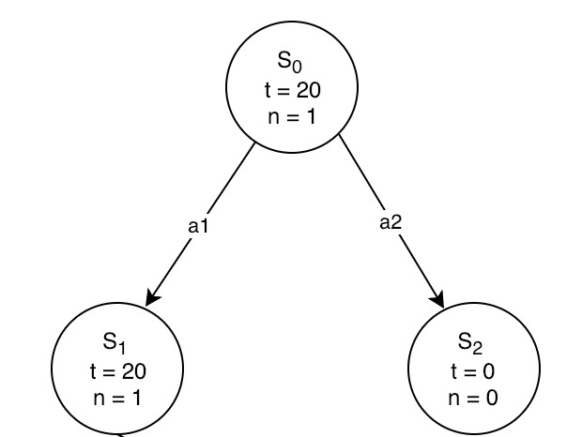
MCTS
After the rollout phase, we propagate the score back up the tree
This is the backpropagation phase
All moves selected in the sequence that lead to the root node of the expansion phase have n incremented by 1.
Additionally, t is incremented for each of those nodes by the rollout reward
We have now completed our first iteration

Slide 33
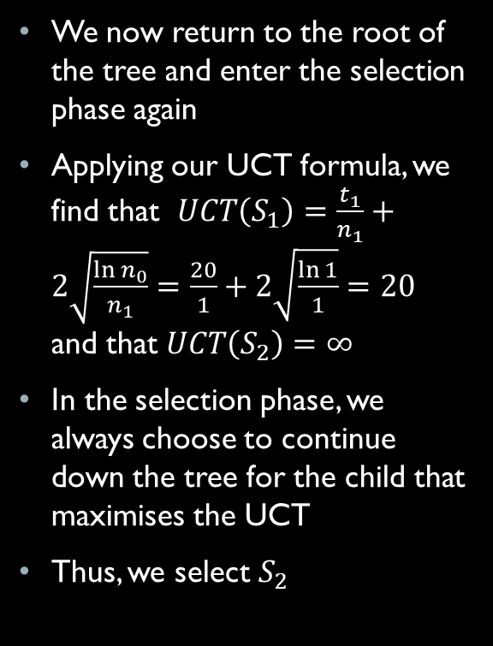
MCTS
We now return to the root of the tree and enter the selection phase again
Applying our UCT formula, we find that $UCT\left(S_{1}\right)=\frac{t_{1}}{n_{1}}+2\sqrt{\frac{\ln{n_{0}}}{n_{1}}}=\frac{20}{1}+2\sqrt{\frac{\ln{1}}{1}}=20$ and that $UCT\left(S_{2}\right)=∞$
In the selection phase, we always choose to continue down the tree for the child that maximises the UCT
Thus, we select $S_{2}$

Slide 34
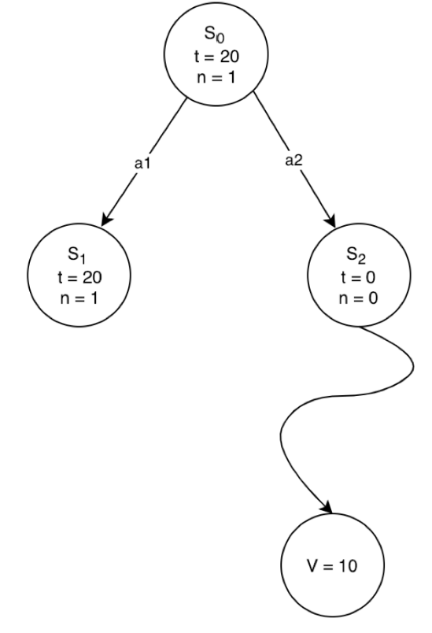

MCTS
As $S_{2}$ is a leaf node that has not yet been visited, we once more commence the rollout phase
This means that, starting at state $S_{2}$we take random actions until we reach a terminal state

Slide 35
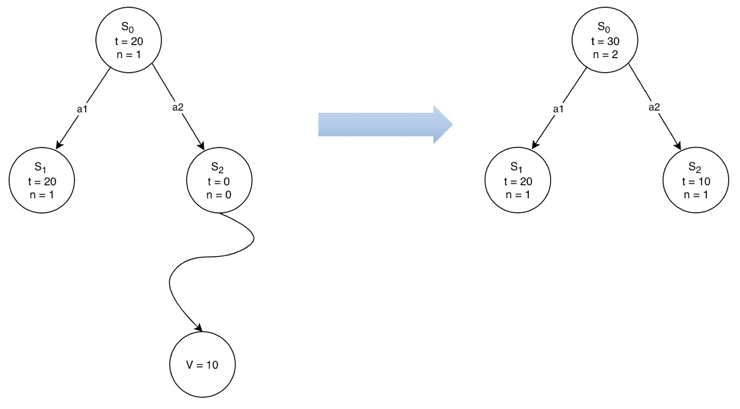

MCTS
The rollout result is propagated back through the tree, with all states that were in the move sequence that lead to the rollout node being updated
In this case, the move sequence was $S_{0}→S_{2}→Rollout$. Thus, for $S_{0}$ and $S_{2}$, we say n = n + 1 and that t = t + 10
This is the end of the second iteration

Slide 36
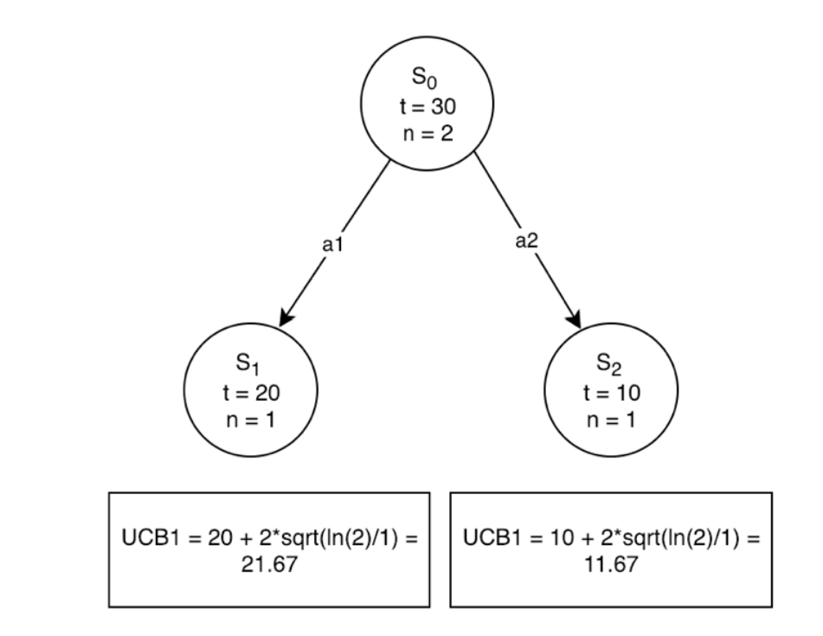

MCTS
We return to the root node and continue with the selection phase
We select the child node that maximises the UCT score
In this case, $UCT\left(S_{1}\right)≅21.67$and $UCT\left(S_{2}\right) ≅11.67$
Thus, we select $S_{1}$

Slide 37
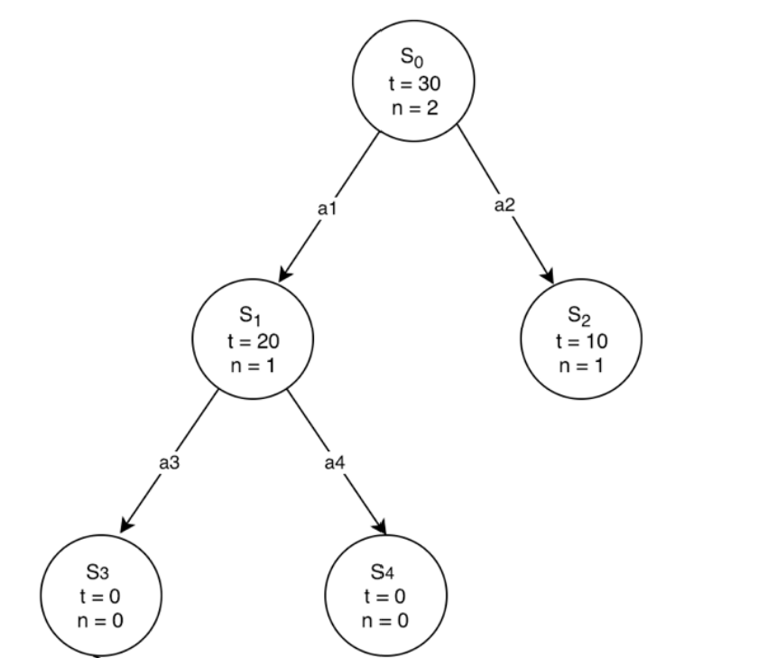

MCTS
We now reach $S_{1}$which is a leaf node
As $S_{1}$ has already been visited at least once, we commence the expansion phase
We, find that two actions can be taken from $S_{1}$, giving us two new states: $S_{3}$and $S_{4}$

Slide 38

MCTS
We now move to selection phase, applying our UCT formula to $S_{3}$and $S_{4}$
We find that they have the same UCT score (namely $∞$). Thus, we randomly choose one
In this case, let’s choose $S_{3}$
We now begin the rollout phase for $S_{3}$

Slide 39
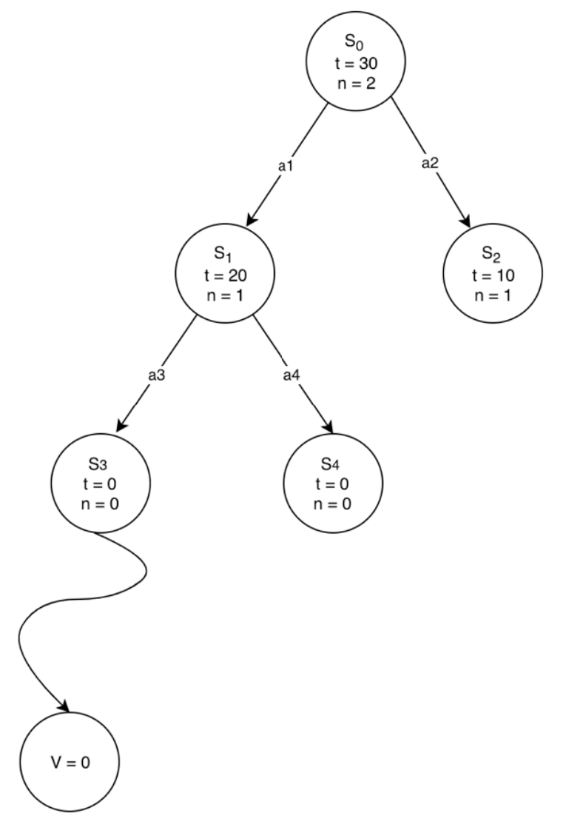

MCTS
This is the rollout phase for $S_{3}$
We play random moves from $S_{3}$ until we achieve a terminal state

Slide 40
MCTS
We can perform MCTS for as many iterations (/ amount of time) as we wish
With more time / iterations, our AI is more likely to pick the best move and find an optimal strategy
MCTS forms the core of the AlphaGo algorithm.
Alpha Go is an AI system that beat the world champion of the board game Go.
Go is similar to chess but hadn’t been solved by AI in the same way that chess had until Deep mind produce Alpha Go in 2016
Like chess, Go is a perfect information game with two players: White and Black, however there are more possible states and heuristic are much harder to develop

Slide 41
Alpha Go
Alpha Go used 30 million Go games from human players to train two neural networks that estimate the value of Go boards and also actions to take in a given board state.
It then uses these networks to optimise the selection and rollout phases of the MCTS. In the rollout phase, the neural network is used to make moves that look good (i.e. not just purely random moves)
In the selection phase, the neural network is used to select moves that are more promising
It then plays against itself to continually improve both of these neural networks using reinforcement learning
This lead to the strongest Go player ever seen up until that point

Slide 42
Deep mind
Deep mind have improved Alpha Go multiple times. They now have a general algorithm that can be applied to any board game (regardless of perfect or imperfect information)
This new algorithm only uses reinforcement learning (and thus requires no human dependent data)
This new algorithm, has beaten the best AI systems in chess, Go, shogi and many other games

Slide 43
Genetic Algorithms
Genetic Algorithms refer to a set of algorithms that emulate biological processes to solve optimisation problems
In order to get an overview of this, field we will look at one of the most common ones, titled NEAT

Slide 44
NEAT
NEAT stands for NeuroEvolution of Augmenting Topologies
This algorithm is used to alter artificial neural networks in an unsupervised fashion
The algorithm is roughly as follows:
Initialise X artificial neural networks with random weights and biases
Let each network play the current state
Evaluate how well each network did using a fitness function
Pick the top n% of networks and splice the weights and biases of these networks together to create X ANN’s
Repeat until stopping criteria

Slide 45
NEAT
The idea is roughly mimicking that of natural selection. The best genes lead to increased survival odds, which increases the chances of “genes” being passed on to the next generation
This is commonly applied in video games
Let’s take the video game “flappy bird” as an example

Slide 46
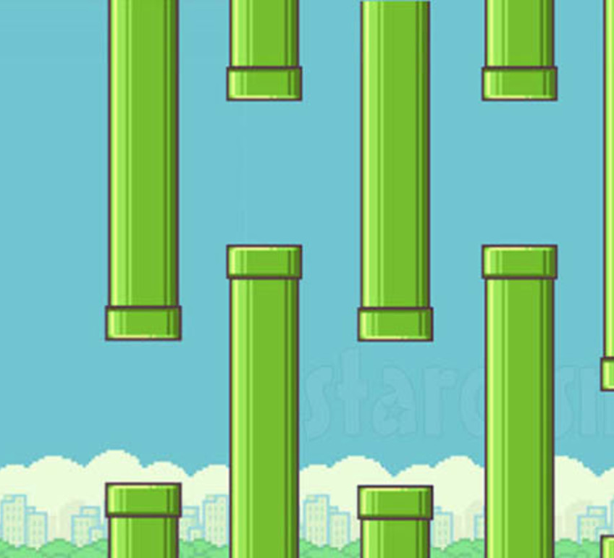
Flappy Bird
In the game, you can either tap the screen or not tap the screen
If you don’t tap the screen, the bird will fall down
If you do tap the screen, the bird will move up (i.e. flap their wings)
The goal is to avoid collision with the pipes for as long as possible to maximise your score
The game can be played here: https://flappybird.io/

Slide 47
Flappy Bird
Let’s design a neural network for our bird agent.
First, let’s consider what data we want to have as an input to the network
We will want to know our location, our vertical velocity, the location of the closest lower pipe and the location of the upper closest pipe.
For each location, we will use both the x and y coordinate
As this is a simple task to perform, we will want a small neural network
This allows real time performance which is critical

Slide 48
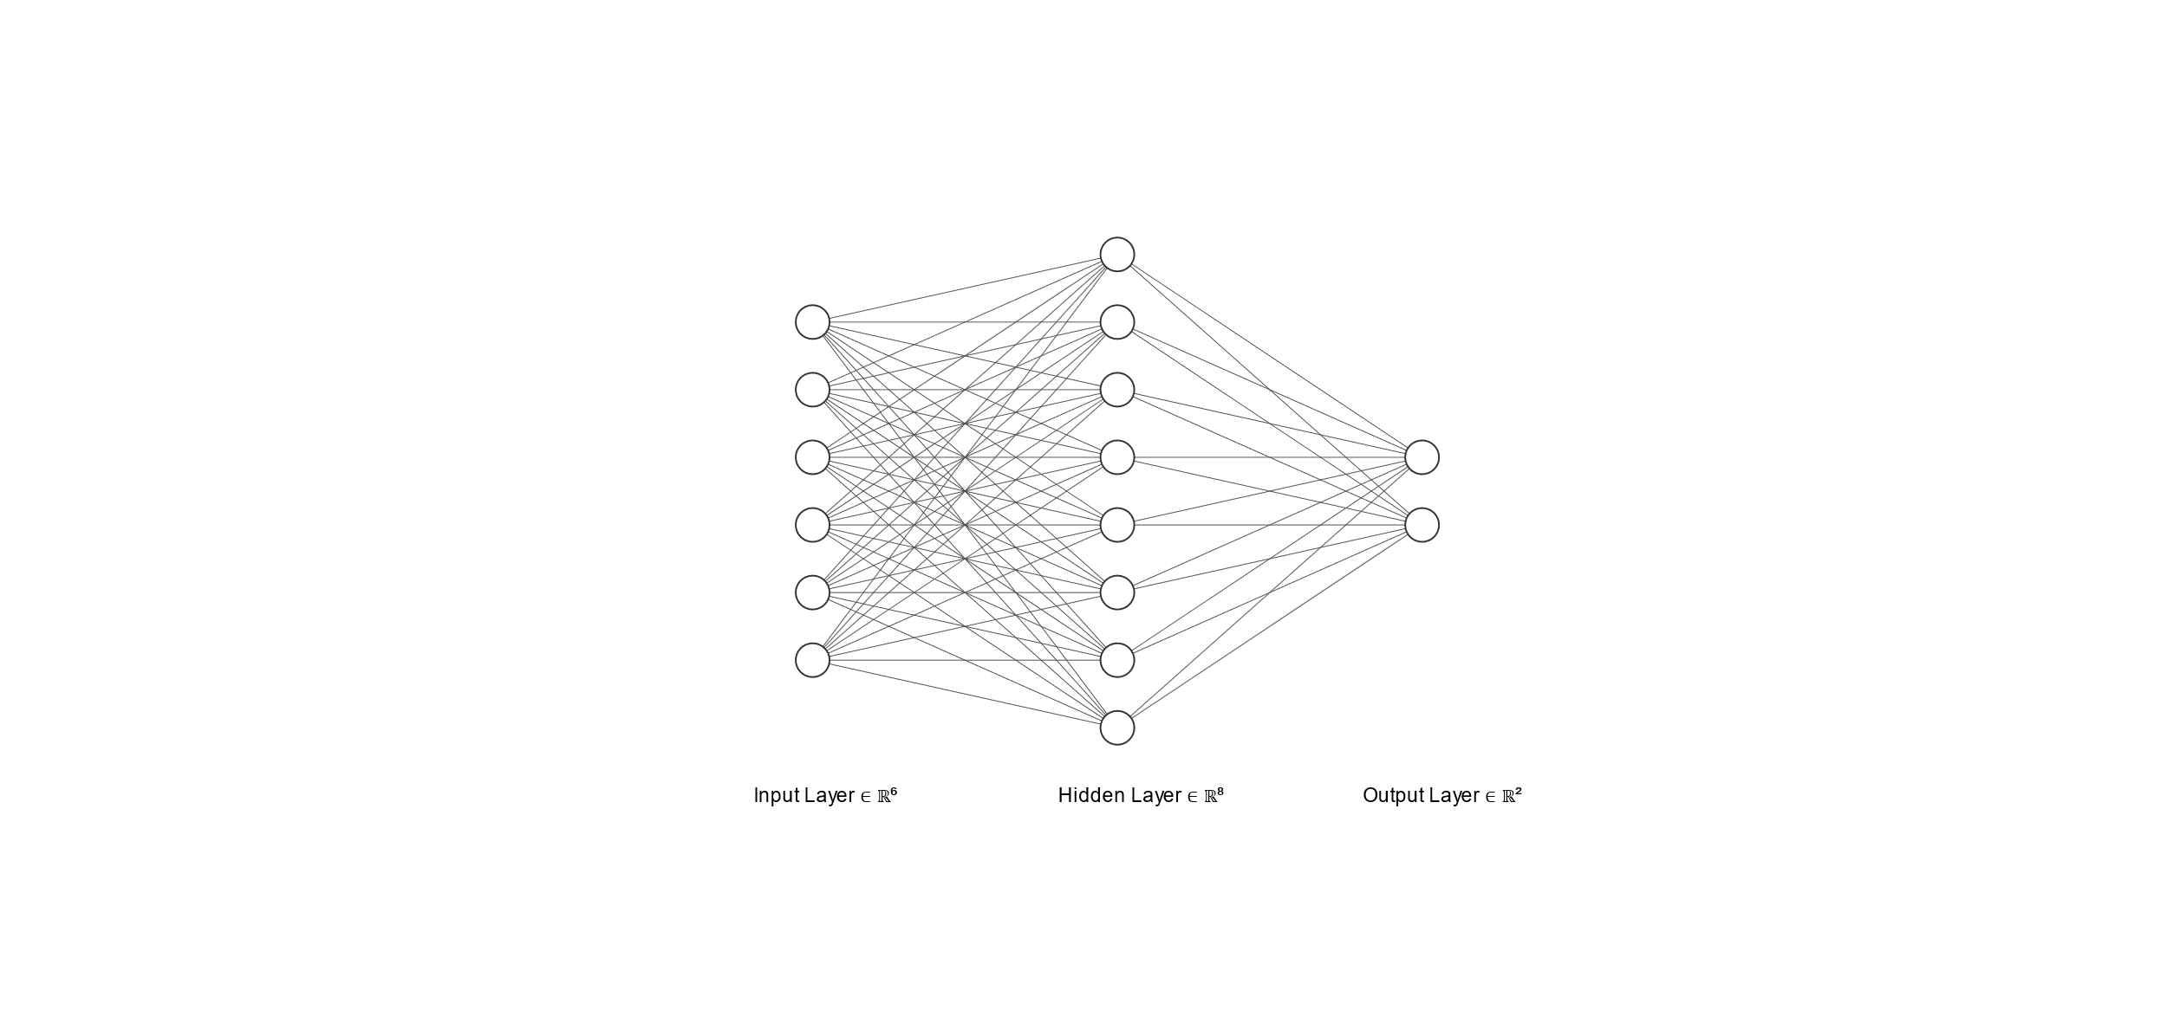
Flappy Bird

Slide 49
Flappy Bird
Bird X coordinate
Bird Y coordinate
Pipe 1 Y coordinate
Flap
Pipe 2 Y coordinate
Don’t Flap
Pipe X coordinate
Bird vertical velocity

Slide 50
Flappy Bird
Let’s have 100 agents per generation
Initially, each agent will have a randomly initialised set of weights and biases
For our fitness function, we will use the horizontal distance travelled
This means that agents that clear more pipes will be more likely to “reproduce” and pass their genes onto future generations
After each generation, we will take the weights and biases from the top 10 neural networks and splice them together to produce 99 new agents
Splicing is complicated but is roughly analogous to how two parents pass their genes on to a child (the precise formula can be found here: http://nn.cs.utexas.edu/downloads/papers/stanley.cec02.pdf )
The final agent for the new generation will be identical to the best performing agent from the previous generation
We repeat this for a certain amount of time

Slide 51
GA
Let’s look at our flappy bird AI in action.
Please download the folder found here: https://github.com/philipmortimer/MNIST-TF/tree/main/11.3_neuroevolution_tfjs.js
Simply double click the “index.html” file and open it in your web browser (e.g. chrome or edge).
You don’t need to have pre-installed anything (like python or Java)!
Credit: https://github.com/CodingTrain/website/tree/main/Courses/natureofcode/11.3_neuroevolution_tfjs.js

Slide 52
Flappy Bird
As you can see, the genetic algorithm is highly effective and learns to play flappy bird very quickly in real time!
As with all forms of ML (included reinforcement learning), there are many variants of genetic algorithms
Although, of course this was a very simple problem

Slide 53
ML Techniques
It can be difficulty to decide what ML technique is suitable for a given problem
Traditionally, the following order of effectiveness is true: supervised, unsupervised, reinforcement then genetic algorithms.
However, this is too generic and the simple answer is that it takes experience to know which type(s) of learning to apply
Alpha Go, represents a breakthrough as the algorithm exceeds any results obtainable from supervised techniques, for example.

Slide 54
Summary
We looked at reinforcement learning, a machine learning technique that has some agent interact with an environment to learn
We discussed q learning, where a q table is generated to assess how good a given move probably is for a given state
We looked at the application of deep neural networks as a way to replace this table for large state spaces
We discussed Monte Carlo Tree search, an advanced search algorithm
MCTS balances taking good actions with evaluating actions that have not been taken often to calculate the best action to take in a given state
It can be thought of as a more versatile extension of the concepts introduced in by the minimax algorithm

Slide 55
Summary
We discussed how Alpha Go combined deep neural networks with MCTS to be the first computer to exceed human skill at the incredibly complex board game Go
Discussed genetic algorithms – algorithms used to solve optimisation problems by emulating biological processes.
We discussed the NEAT algorithm which creates a set of agents to tackle a problem. It selects the best agents to combine their genes for the next generation
This approach allowed us to produce a neural network that achieves perfect flappy bird play

Slide 56

Questions
Please ask any questions about this lesson OR any part of the course
This is the last lesson, so now is the time to discuss anything you wish to talk about!

Slide 57
Further Reading
Q learning: https://www.freecodecamp.org/news/an-introduction-to-q-learning-reinforcement-learning-14ac0b4493cc/
Deep Q Learning: https://www.analyticsvidhya.com/blog/2019/04/introduction-deep-q-learning-python/#:~:text=In%20deep%20Q%2Dlearning%2C%20we,is%20generated%20as%20the%20output.
MCTS: https://www.analyticsvidhya.com/blog/2019/01/monte-carlo-tree-search-introduction-algorithm-deepmind-alphago/
Alpha Go: https://jonathan-hui.medium.com/alphago-how-it-works-technically-26ddcc085319 https://www.youtube.com/watch?v=WXuK6gekU1Y
Genetic Algorithms: https://www.youtube.com/watch?v=9zfeTw-uFCw&t=107s https://www.youtube.com/watch?v=cdUNkwXx-I4

Slide 58
End of Course
This is the end of my introduction to AI
Thanks for watching!
Hopefully, you should have a high level overview of a range of common AI techniques (even if you don’t understand all of the low level maths)
You now understand neural networks, supervised learning, deep learning, unsupervised learning, reinforcement learning, genetic algorithms, graph traversal (DFS, BFS etc.), minimax and AI design principals
You now have all the tools you need to tackle an AI problem of your choosing
Remember, if you get stuck, always use Google. This will more often than not resolve your issues

Slide 59
Next Steps
If you wish to continue pursuing machine learning, I would recommend attempting to code some of the projects I discussed in this course.
For example:
A tic tac toe playing minimax AI using alpha beta pruning. For an extension, implement iterative deepening and move ordering optimisations live PV search
A BFS that calculates the degree of separation between actors
An ANN using TensorFlow that classifies the MNIST dataset
A CNN using TensorFlow for cancer recognition
Perform K means clustering on a dataset
Implement MCTS on noughts and crosses
Attempt your own project

Slide 60
Next Steps
If you wish to brush up on AI, this is a brilliant resource: https://www.youtube.com/watch?v=LucW-p6zC5c&list=PLBw9d_OueVJS_084gYQexJ38LC2LEhpR4
Otherwise, simply read up on area of interest, problem online. There’s lots of documentation and discussion easily available for free on the web
This is perhaps the best single place to start your future journey if you wish: https://www.tensorflow.org/resources/learn-ml
I would be open to doing custom work / future teaching / whatever you wish if that’s something that interests you
You can contact me on Fiverr at https://www.fiverr.com/philiplearning
Alternatively, feel free to email me at “philipmortimer99@aol.com”

Slide 61
THANK YOU
Thank you so much for taking this course!
All the best with the future!!

